Slide 1
Vehicle Insurance Fraud Detection
Presented by Group 19:
Bian Tong A0234470L
Kang Xuan Hui Victoria A0241262R
Ke Jiayi A0241155N

Slide 2

01
Motivation

Slide 3
$29 Billion
Annual Premium Leakage in the United States alone

Slide 4
Types of Vehicle Fraud
& Why is it Challenging?
Types
Why is it challenging?
Staged Accidents
Exaggeration of Damages or Injuries
Vehicle Theft Fraud
Ghost Claims
Identity Fraud
Complexity of Fraudulent behaviour
Data Overload
Lack of clear fraud indicators
Human element and Subjectivity
Legal and Ethical Concerns

Slide 5

02
Problem Statement

Slide 6
02
Given the complexity of the vehicle insurance claims, how can we detect fraudulent claims in a sea of legitimate ones?
Problem Statement

Slide 7

03
Our
Dataset

Slide 8
Vehicle Insurance Claims in the
United States circa 1990s
Fraud_oracle.csv
From Vehicle Insurance Industry
9.41 Kaggle usability
33 features
15,420 records
6% (923) fraudulent.

Slide 9

04
Data Preprocessing
& Modelling

Slide 10
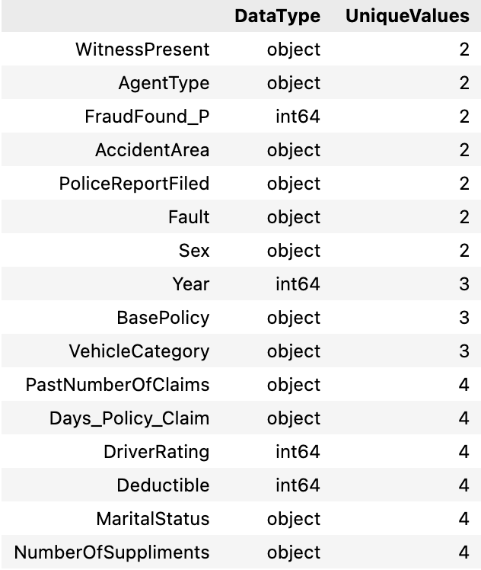
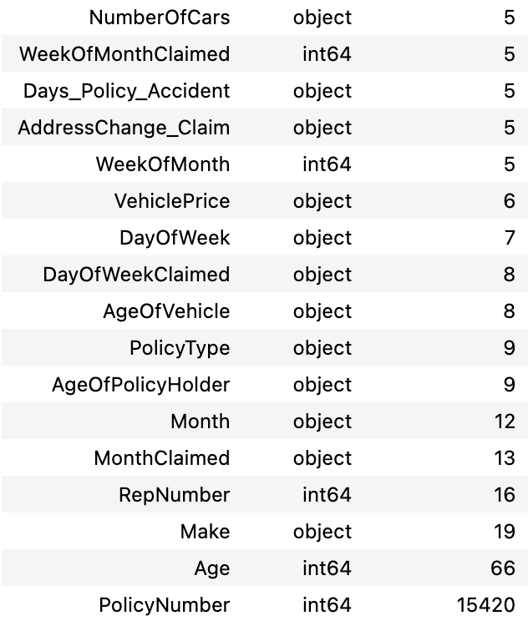
Data Preprocessing - Convert Data Type

Slide 11
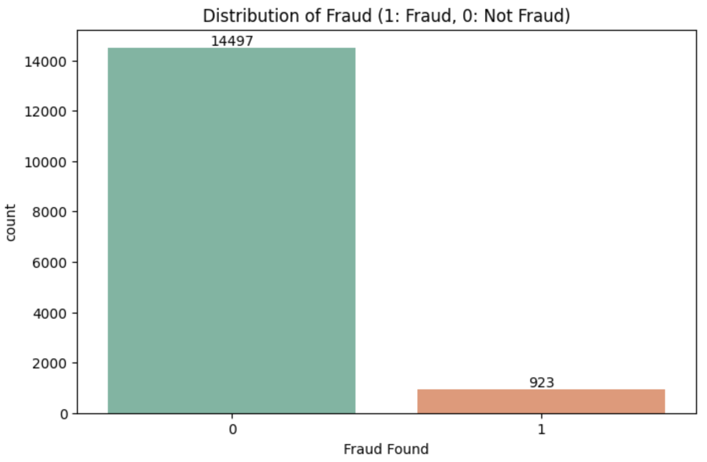
Data Preprocessing - SMOTE

Slide 12
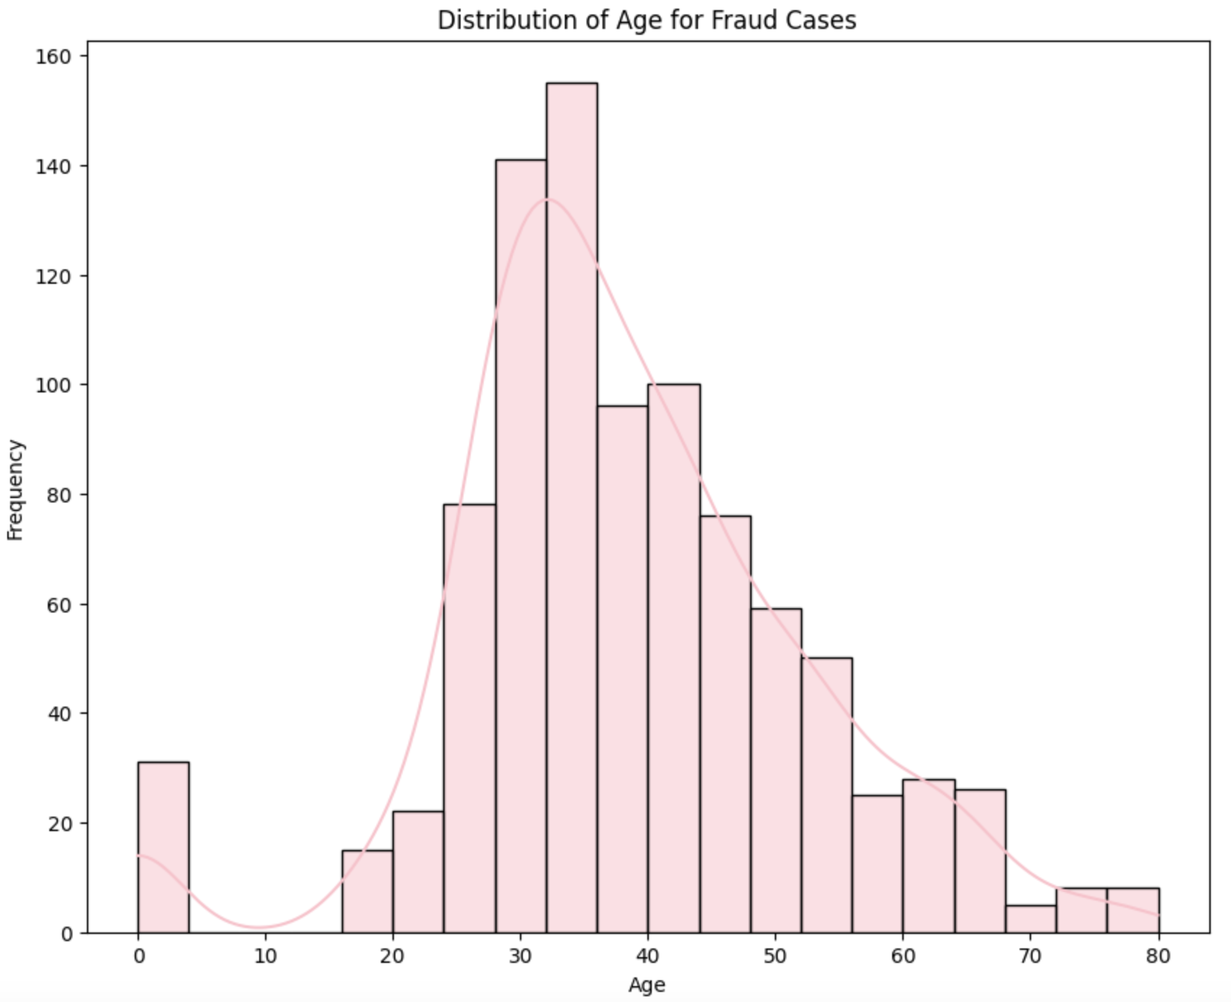
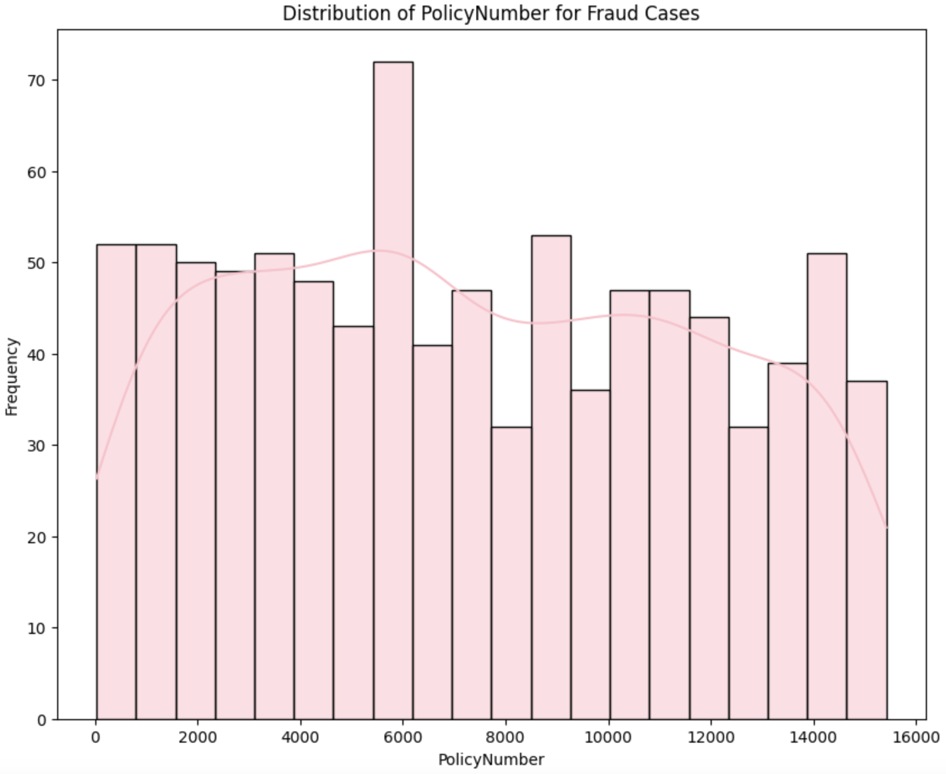
Data Preprocessing - Drop Useless Columns

Slide 13
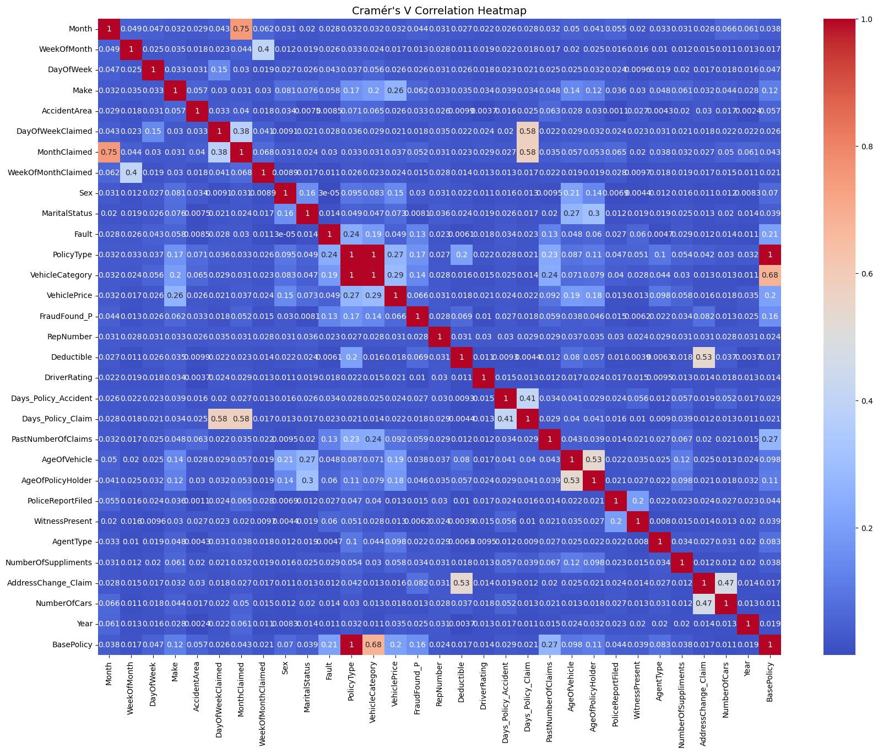
Data Preprocessing - Drop Highly Correlated Columns

Slide 14
Data Preprocessing - Feature Encoding
Binary
Ordinal
Label Encoding to
0 and 1 indicating
True and False
Specified mappings to retain the ordering.
Nominal
month_mapping = {'Jan': 1, 'Feb': 2, 'Mar': 3, 'Apr': 4, 'May': 5, 'Jun': 6,
'Jul': 7, 'Aug': 8, 'Sep': 9, 'Oct': 10, 'Nov': 11, 'Dec': 12}
day_of_week_mapping = {'Monday': 1, 'Tuesday': 2, 'Wednesday': 3,
'Thursday': 4, 'Friday': 5, 'Saturday': 6, 'Sunday': 7}
Auto Label Encoding

Slide 15
Data Preprocessing - Others
Scaling
Train-Val-Test Split
Drop NA
Standard Scaler
56%-14%-30%
Make sure no NA before training

Slide 16
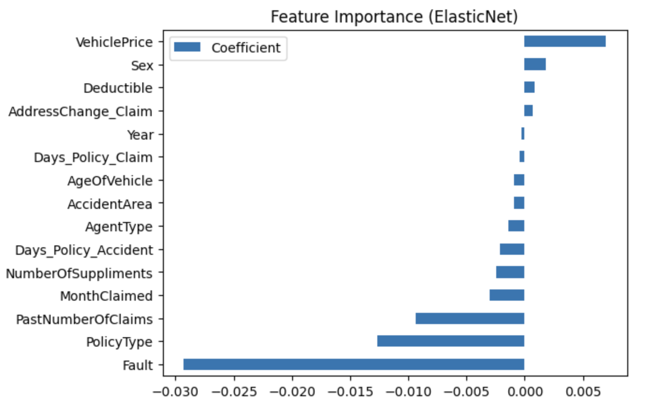
Feature Selection - ElasticNet

Slide 17
Modelling - SMOTE vs Non-SMOTE
Logistic Regression
Random Forest
XGBoost
Baseline model, limited in capturing non-linear relationship.
Ensemble model, good at handling non-linear relationship.
Highly efficient in handling imbalanced dataset.
CatBoost
Neural Network
KNN
Handling of categorical variables, robust against overfitting.
Capture complex patterns, sensitive to data imbalance.
Simple non-parametric, less effective with imbalance data.

Slide 18
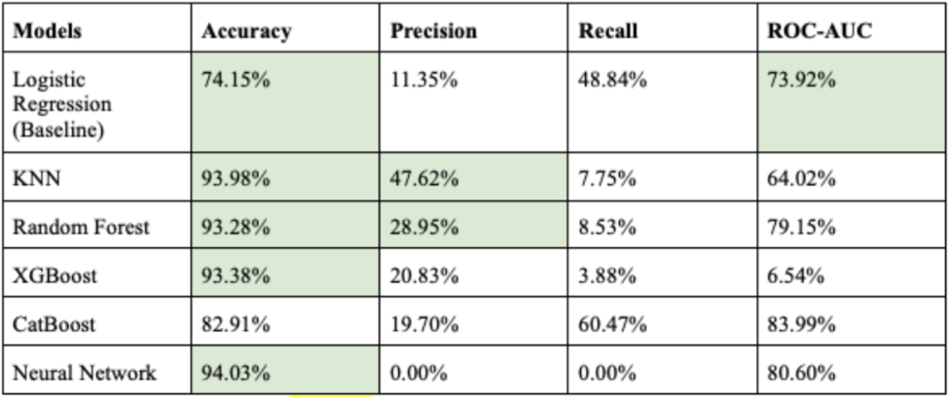
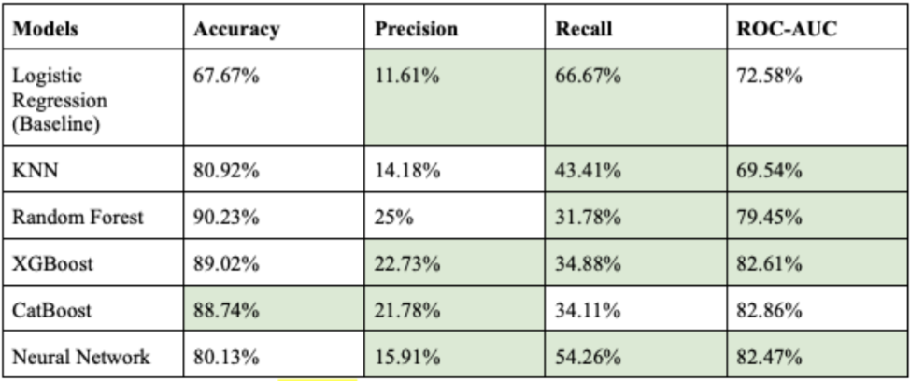
Non-
SMOTE
SMOTE

Slide 19
05
Results
Notes:
Let’s move on to the results.

Slide 20
Model Results After Hyperparameter Tuning
Models | ACCURACY | PRECISION | RECALL | ROC-AUC
LOGISTIC REGRESSION | 66.33% | 10.97% | 65.12% | 72.67%
KNN | 79.16% | 15.03% | 53.49% | 75.04%
RANDOM FOREST | 89.12% | 22.40% | 33.33% | 81.74%
XGBOOST | 88.78% | 21.19% | 32.13% | 82.59%
CATBOOST | 70.73% | 13.71% | 73.64% | 80.60%
NEURAL NETWORK | - | - | - | -
Notes:
During hyperparameter tuning, we prioritized recall as our main metric, focusing on the model's ability to identify fraudulent claims, even at the cost of false positives. This aligns with our business needs, where the cost of investigating false positives is far lower than the risks of undetected fraud.
The tuned CatBoost model achieved a recall of 79.42%, outperforming others and proving more effective for handling imbalanced data. While models like Random Forest and XGBoost excelled in accuracy, they struggled with recall, often missing fraudulent claims. The trade-off between recall and precision highlights the complexity of fraud detection, but prioritizing recall ensures more potential fraud cases are flagged for review.

Slide 21
Integration of the model into the business process
CLAIM PRE-SCREENING
ENHANCED FRAUD DETECTION WORKFLOW
REAL-TIME DECISION SUPPORT
Automatically analyse incoming insurance claims and assign a fraud risk score to each submission.
Supplement traditional rule-based approaches with advanced, data-driven insights.
Provide instant fraud risk assessments to identify potentially fraudulent claims early in the process.
Notes:
The model can be integrated into the claims process in three ways:
Firstly, claim pre-screening. Our model can automatically analyse claims and assign fraud risk scores, flagging high-risk ones for further investigation. This reduces adjusters' workload and focuses resources on likely fraud cases.
Secondly, enhanced fraud detection. Our model can augment rule-based systems with advanced insights, detecting subtle patterns and anomalies like repeated claims, creating a more robust workflow for identifying sophisticated fraud schemes.
Lastly, the model can also function as a real-time decision support to provide instant fraud risk assessments during claim evaluations, improving efficiency and reducing delays for legitimate claims, benefiting both insurers and policyholders.

Slide 22
Additional Insights from Experiments
Reducing Decision Thresholds
Trade-offs with precision, accuracy and ROC-AUC
Notes:
Some additional insights from our experiments was that we tried adjusting the decision thresholds to enhance recall. Though it significantly improve the model's ability to identify potential fraud cases, this came with trade-offs as well. Precision dropped, increase in false positives, and metrics like accuracy and ROC-AUC declined. These trade-offs highlight the challenges of balancing recall with other metrics in fraud detection.

Slide 23
Limitations
OUTDATED DATASET
GEOGRAPHICAL BIAS
HUMAN OVERSIGHT
Dataset used is nearly 30 years old. Advancements in technology have transformed fraud detection and monitoring methods
Limited generalisability of the findings to other regions
Fraudulent claims often involve complex and nuanced contexts that automated systems may not fully capture.
Notes:
Moving on to our limitations, one key limitation is that the dataset used for this study is nearly 30 years old. During this time, advancements in technology—such as closed-circuit television (CCTV) and widespread use of dashboard cameras—have transformed fraud detection practices. These tools provide real-time evidence of accidents, simplifying fraud identification. As a result, the study’s insights may not fully reflect the impact of these modern developments.
Secondly, the dataset is sourced exclusively from the United States, which limits the generalizability of the findings to other regions. Differences in driving regulations, insurance structures, and vehicle types across countries can influence fraud patterns. For example, stricter driving laws or alternative insurance models in other regions may result in fraud behaviors not captured by this study. These geographical differences must be considered when adapting the model for global use.
Lastly, while the model provides valuable insights, human oversight still remains critical. Fraudulent claims often involve complex and nuanced contexts that automated systems may not fully capture. Adjusters and fraud teams must validate the model’s outputs to ensure accurate and fair claim assessments.

Slide 24
Conclusion
CATBOOST
RELEVANCE
FUTURE WORKS
Can identify fraudulent insurance claims with a high recall score.
Despite advancements, claims data have remained consistent, ensuring the applicability of our findings to modern fraud detection scenarios.
Focus on addressing challenges in detecting minority class instances more effectively
Notes:
To conclude, our experiments demonstrate that the CatBoost model can identify fraudulent insurance claims with a high recall score. This study also provided valuable insights into the effectiveness of predictive models for vehicle insurance fraud detection. Despite technological advancements, the core characteristics of claims data have remained consistent, ensuring the applicability of our findings to modern fraud detection scenarios. This enables insurers to identify similar patterns and improve their fraud detection practices.
To further improve the system, our next steps will focus on addressing the challenges in detecting minority class instances more effectively. We could explore more sophisticated resampling methods to better handle class imbalance, ensuring the model is exposed to enough examples of fraud during training.

Slide 25
Thank You
Notes:
Thank you!

